Slide 1
1LifeLegacy 1st Annual Christmas Donation Campaign 2010

Slide 2

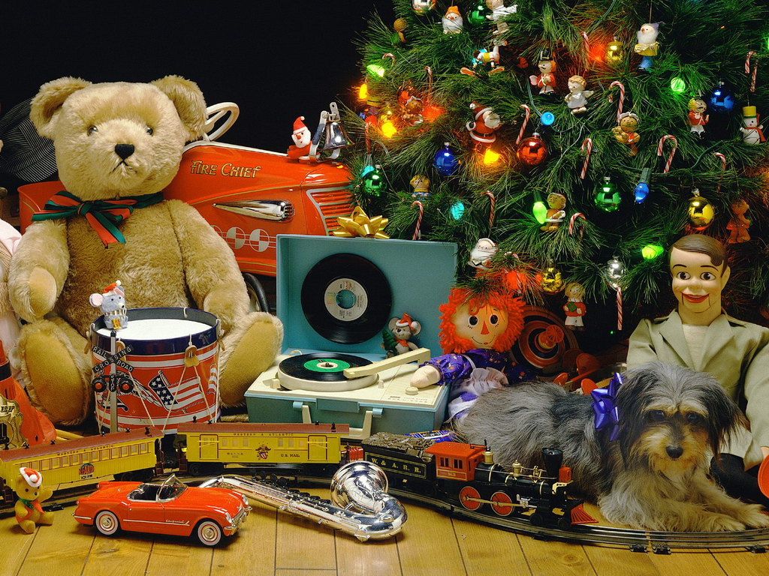
1LifeLegacy 1st Annual Christmas Donation Campaign 2010

Slide 3

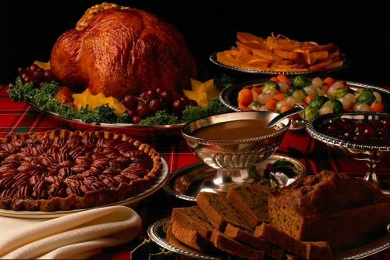
1LifeLegacy 1st Annual Christmas Donation Campaign 2010

Slide 4

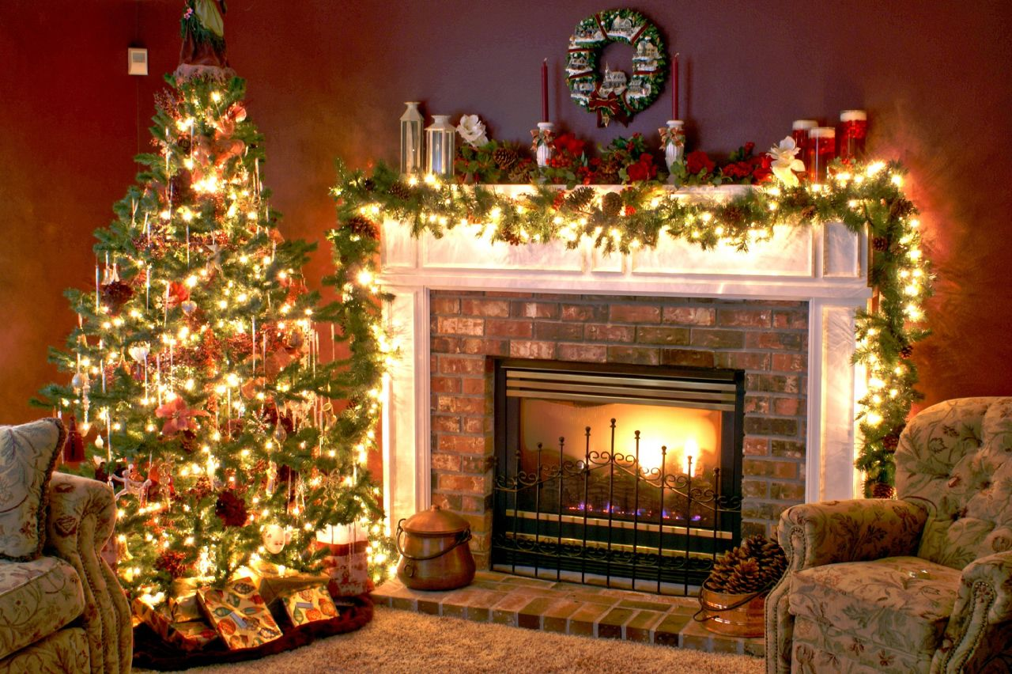
1LifeLegacy 1st Annual Christmas Donation Campaign 2010

Slide 5

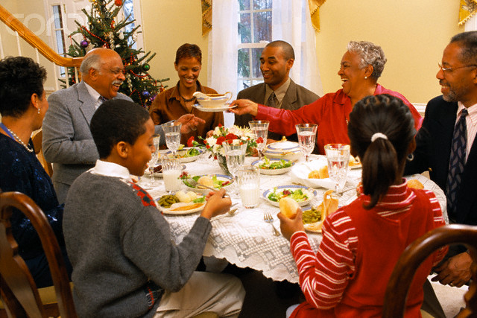
1LifeLegacy 1st Annual Christmas Donation Campaign 2010

